Slide 1

TuneScope: Big Data Analytics on Spotify
Analyzing music patterns, sentiments, and popularity using Databricks and PySpark — a practical pipeline and dashboard for media & entertainment analytics.
By: Boddapati Kanchana (Roll No: 24MBMB02)

Slide 2

Executive Summary
The project demonstrates scalable music analytics by combining audio metadata with lyrical text. We process Spotify song features and lyrics at scale using Databricks to generate actionable insights for product, A&R, and content teams.
Datasets: Spotify songs metadata (~10K) + lyrics corpus
Tech: Databricks (PySpark, MLlib), TextBlob, scikit-learn
Deliverable: TuneScope — interactive analytics dashboard
Key insight: Big Data + ML + NLP => scalable, data-driven recommendations for song discovery and artist strategy.

Slide 3




Project Objectives
Scalable pipeline
Feature integration
Implement Bronze→Silver→Gold layers in Databricks for reliable ingestion and lineage.
Combine audio features (danceability, energy, valence) with derived lyric features for richer modelling.
Popularity modelling
Interactive dashboard
Train and evaluate regression models to predict song popularity at scale.
Expose insights via TuneScope for analysts and product teams.

Slide 4
Dataset Overview
Spotify Songs Dataset
Lyrics Dataset
~10,000 tracks with standardized audio features
Raw lyric text linked to tracks
Key fields: danceability, energy, valence, tempo, popularity, instrumentalness
Processed for sentiment, emotion scores and lexical richness
Used for feature engineering and model inputs
Used to derive lyrical features and sentiment labels

Slide 5



System Architecture
Structured Bronze → Silver → Gold data pipeline, designed for reproducibility, versioning and downstream ML.
1. Bronze — Raw ingestion
2. Silver — Cleaning & integration
3. Gold — Feature engineering & modelling
Ingest raw Spotify metadata and lyrics; timestamped Delta files for audit.
Schema harmonisation, deduplication, basic NLP tokenisation, and join keys.
Aggregate features, compute sentiment/emotion, train models and persist artifacts.

Slide 6

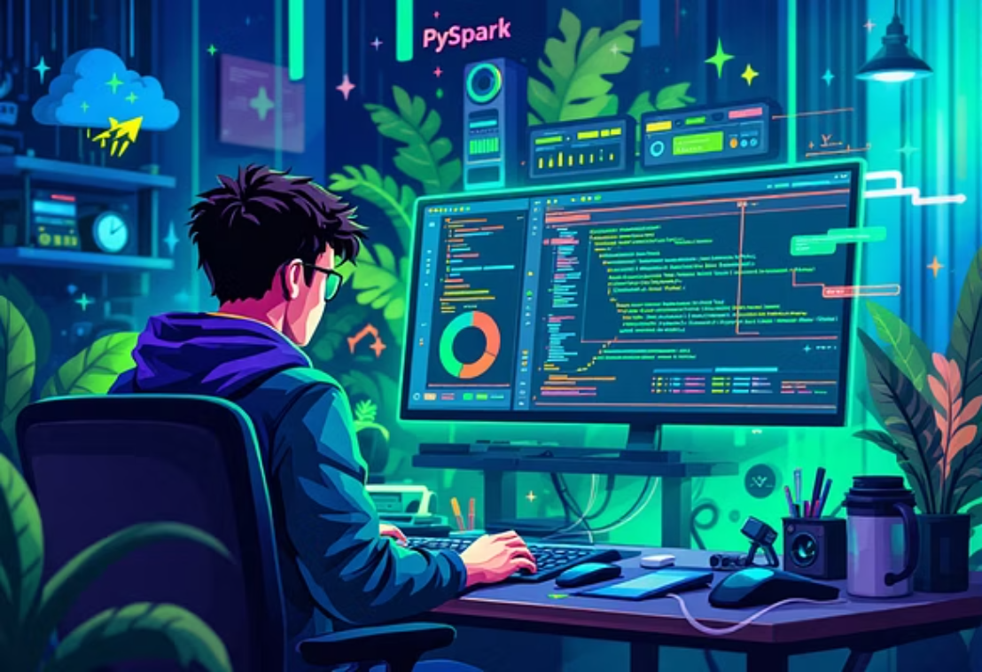
Tools & Technologies
Databricks (PySpark notebooks, Delta Tables)
Delta for storage, versioning & ACID transactions
PySpark MLlib — distributed regression pipelines
Dashboards via Databricks display() and embedded visuals
TextBlob — rapid sentiment extraction
scikit-learn — clustering (MiniBatch KMeans) for profiling
CI: notebook parameterisation + model registry

Slide 7
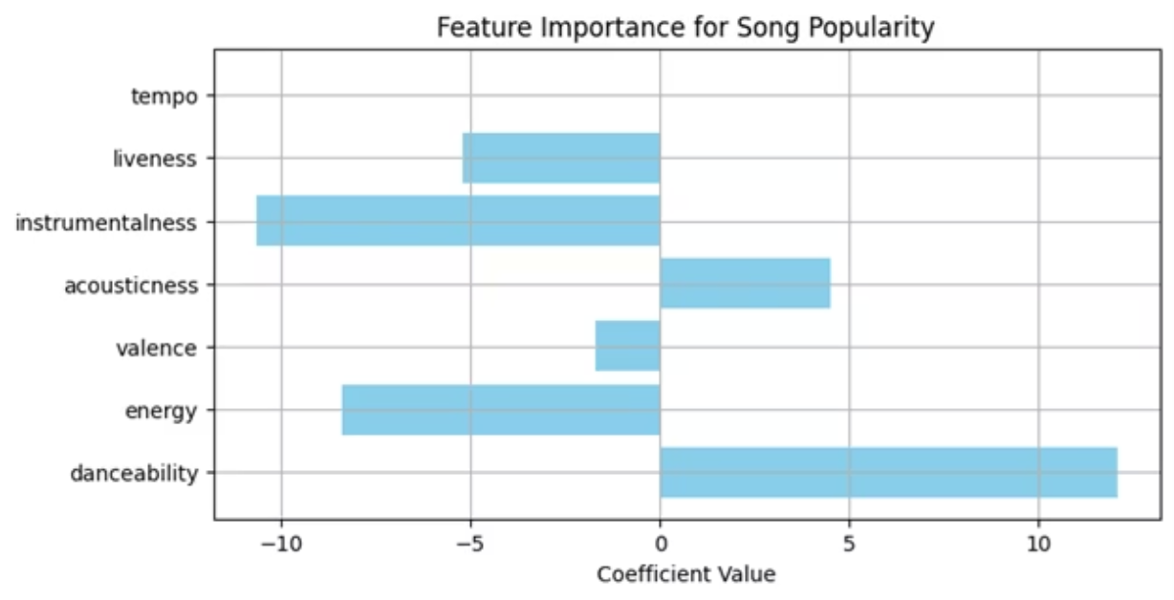
Use Case 1 — Song Popularity Prediction
Objective: Predict track popularity using audio-derived features and lyrical signals. Model trained and evaluated at scale on Databricks.
0.73
Top
R² score
Key drivers
Model explains 73% of variance — robust baseline for product experiments.
Danceability & valence (positive). Instrumentalness (negative).

Slide 8
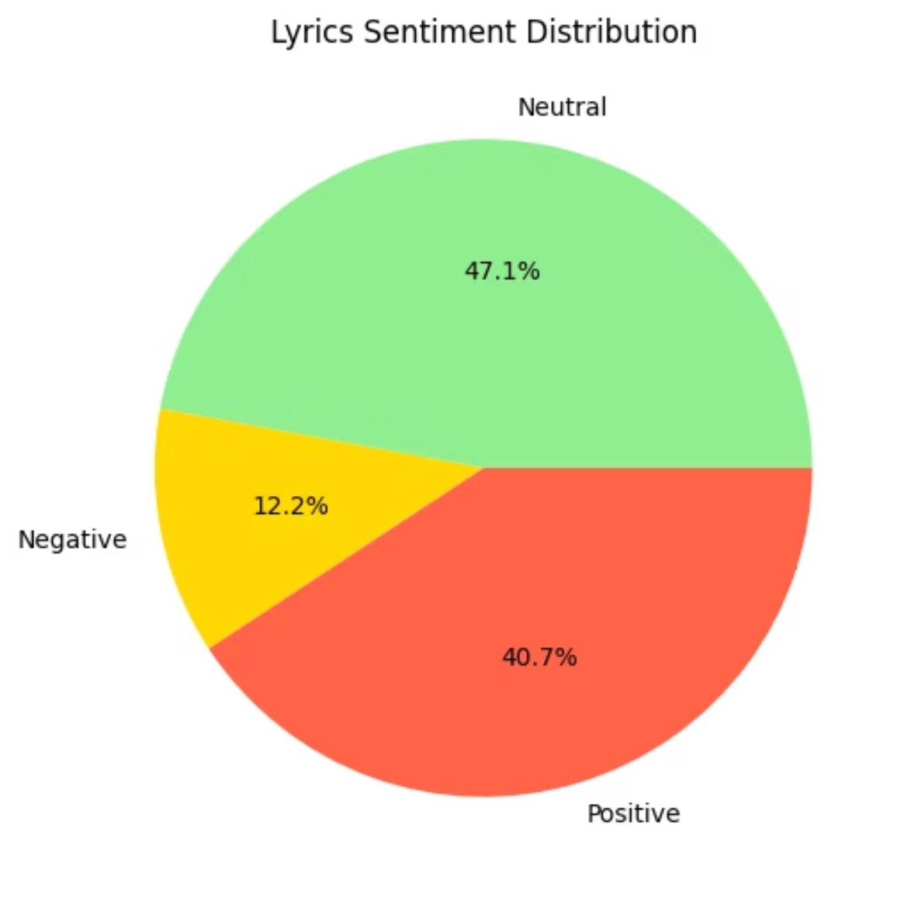
Use Case 2 — Sentiment Analysis of Lyrics
Approach: Use TextBlob for polarity classification, then aggregate per track and per artist for trend analysis.
Sentiment
Share
Neutral
47.1%
Positive
40.7%
Negative
12.2%
Insight: Positive and neutral sentiments dominate popular tracks — useful for curation and recommendation tuning.

Slide 9



Use Case 3 — Genre-Based Song Profiling
We profile genres by aggregating mean audio features and clustering tracks to reveal listening-context behaviour.
EDM / Rock
Pop / Rap
R&B / Acoustic
High average energy and tempo — peaks during workouts and parties.
Moderate energy, high valence — broadly appealing across playlists.
Lower energy, intimate dynamics — fits focused and relaxation contexts.
Insight: Energy and valence align strongly with listening context—informing playlist assembly and targeted recommendations.

Slide 10
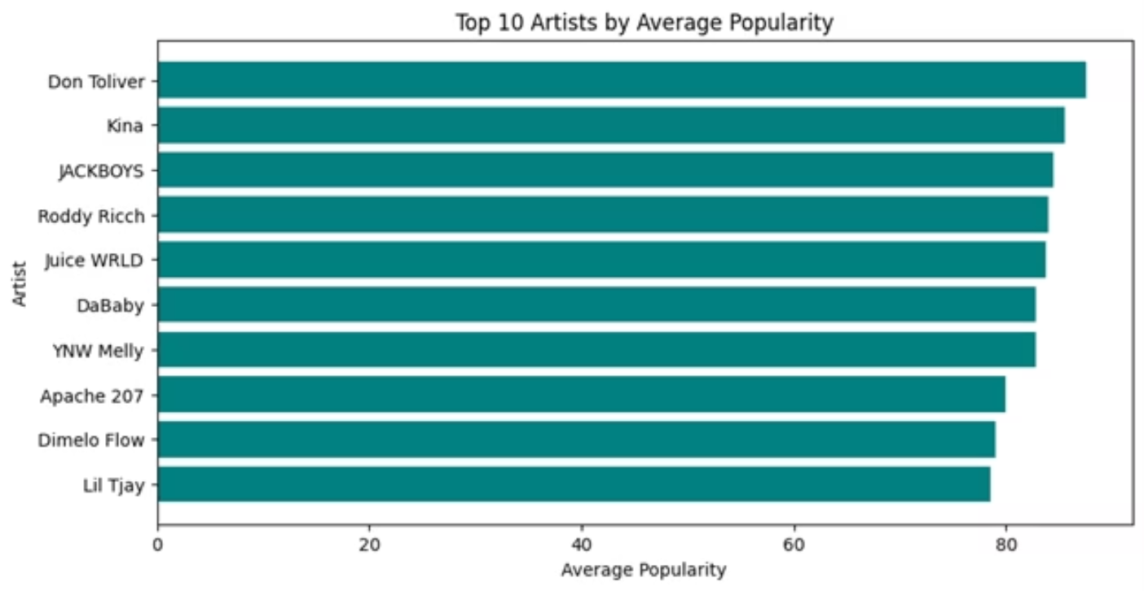
Use Case 4 — Artist Performance & Diversity
We measure artist performance by average popularity, lyrical diversity, and collaboration frequency. Correlational analysis highlights patterns supporting discovery strategies.
Top performers identified: Don Toliver, Kina, JACKBOYS, Roddy Ricch
Finding: Popularity often correlates with emotional variety and cross-artist collaborations
Action: Leverage collaboration networks for recommendation boosts and A&R scouting

Slide 11












Use Case 5: Song Clustering for Enhanced Discovery
Danceability
Energy
Rhythmic stability and tempo.
Intensity and activity level.
Sentiment
Valence
Emotional tone of lyrics/title.
Musical positivity (happy vs. sad).
Tempo
Acousticness
Speed of the track (BPM).
Presence of acoustic elements.

Slide 12



TuneScope The Integrated Analytics Dashboard
Dashboard Name: TuneScope
Integrated Insights
A unified platform for data-driven music intelligence, designed for product managers and data scientists.
Seamlessly integrates outputs from all five analytical use cases into a coherent visual story.
Interactive Visuals
Enables Exploration
Features a range of visualisations including Bar Charts, Pie Charts, and Scatter Plots for deep data exploration.
Allows users to interactively filter, segment, and drill down into music consumption patterns and trends.

Slide 13



Conclusion
Strategic Integration
Actionable Insights
Enhanced Decision-Making
TuneScope successfully integrates Big Data processing, Machine Learning models, and Natural Language Processing (NLP) techniques.
Our analysis of Spotify data revealed crucial insights across popularity, emotional sentiment, and genre trend identification.
The project demonstrated how robust analytics significantly enhances decision-making in the media and entertainment industry.

Slide 14
Acknowledged Limitations and Scope
Dataset Size
Resource Constraints
The analysis was restricted to a dataset size of 10,000 songs, impacting the generalisability of some trend analyses.
Development was limited by the computational resources available within the Databricks Community Edition (CE) environment.
Technology Stack
NLP Technique
The current implementation does not include integration with real-time data streaming or sophisticated deep learning architectures.
Sentiment analysis relied on lexicon-based NLP (TextBlob), which lacks the nuance of more advanced, context-aware models.

Slide 15


